Slide 1

Sensor Kit (Kit 1)
ZAS Robotics Training

Slide 2



Sensor Kit - Contents
Sensor Kit Components
Sensor Creative Board

Slide 3



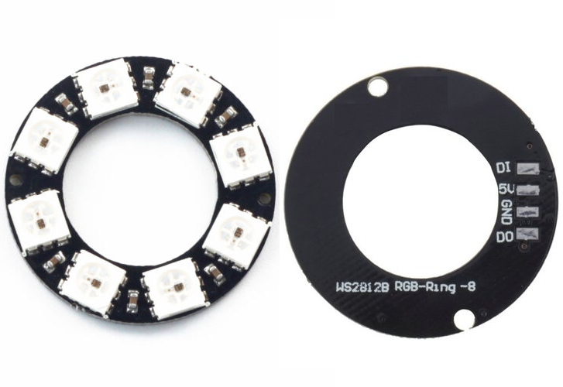

SFL14: NEOPIXEL(8 PIXELS)
Things Needed

Slide 4
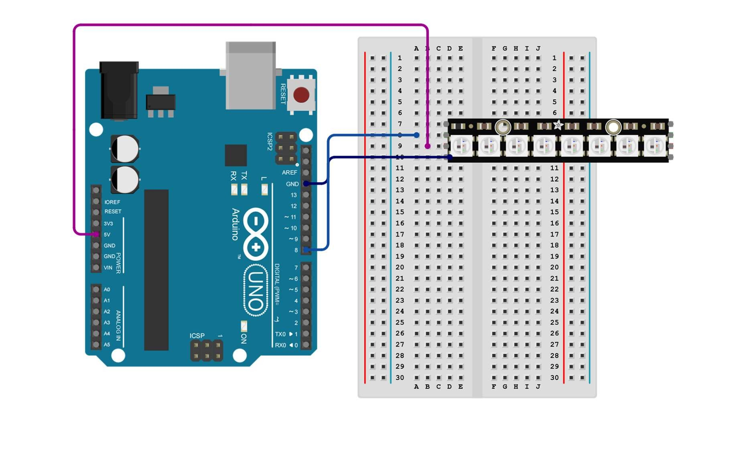
SFL14: NEOPIXEL(8 PIXELS)
Arduino pins | Breadboard
GND | GND
5V | VCC
D8 | DO(output)

Slide 5
SFL14: NEOPIXEL(8 PIXELS)
Creates a NeoPixel object with 8 LEDs on Pin 8
pixels.begin() starts communication with the NeoPixel ring
LOOP (repeats forever)
Color Cycling
Moves through each LED one by one
Lights it Red → Green → Blue → OFF
Shows each color with a 500 ms delay
Rainbow Effect
Uses two loops to generate a flowing rainbow animation
Each LED gets a different shade based on position
Updates colors gradually and repeats
delay(50) controls animation speed
Code for Lesson14:
https://github.com/info-zas/zas-robotics-sensors/blob/main/01_FoundationProjects/01_Code/_16_CreatingLightEffectsWithNeoPixelRing/_16_CreatingLightEffectsWithNeoPixelRing.ino

Slide 6
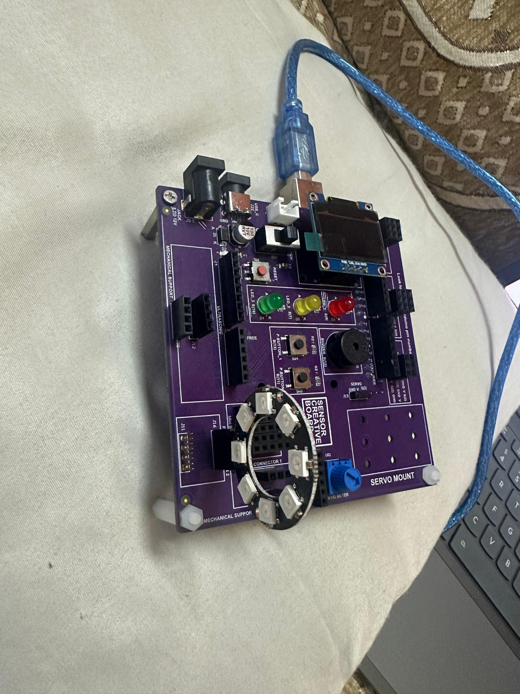
SFL14: NEOPIXEL(8 PIXELS)

